Slide 1
Graduation Project Hardware Summery

Slide 2
Agenda
EEG Signal Characteristics
What is P300
1020 system
Electrodes
ADC
Protection
Amplifier
Notch filter
High pass filter
Low pass filter
Another amplifier
Data transmission
Sampling frequencies

Slide 3
EEG Signal Characteristics
in order to describe any wave, we need to know two features of it: the strength and the frequency (cycles per second).
The frequency ranges from 1 to 50 times per second
The strength of current, or the voltage range of the neurons is from 0 to 200 microvolts
Based on these two characteristics the commonly seen brain waves are divided into: Alpha, beta, theta, delta.

Slide 4
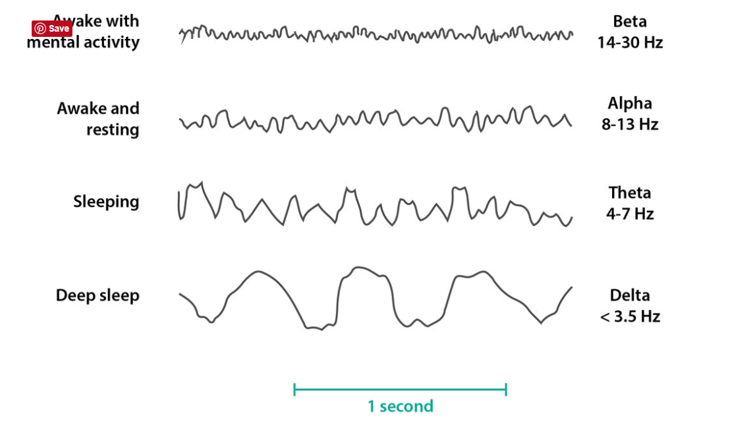
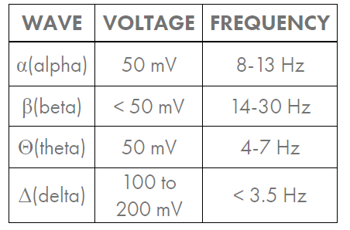
EEG Signal Characteristics

Slide 5

WHICH WAVE SHOULD WE CONSIDER WHEN DESIGNING THE CIRCUIT?

Slide 6
What is P300
-The P300 is an event-related potential (ERP) endogenous component that has a positive deflection that occurs in the scalp-recorded electroencephalogram (EEG) and typically elicited approximately 300ms after the presentation of an infrequent stimulus (such as visual, auditory, or somatosensory). [1]

Slide 7
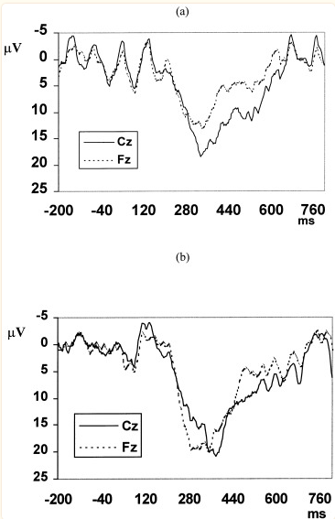
- data collected 129 electrodes from 15 healthy subjects.
- The peak of the P300 recorded at the vertex is 11.10 ± 7.19 μV in amplitude with latency of 328 ± 17 ms for the rare events, and 13.22 ± 6.34 μV in amplitude with latency of 337 ± 33 ms for the novel events. Notably, in response to the rare events, the peak of P300 recorded at the Fz electrode is smaller in amplitude although occurring about the same time as that recorded at the Cz electrode. On the other hand, in response to the novel events, the peak of P300 recorded at the Fz electrode has similar amplitude with and occurs earlier than that recorded at the vertex.

Slide 8
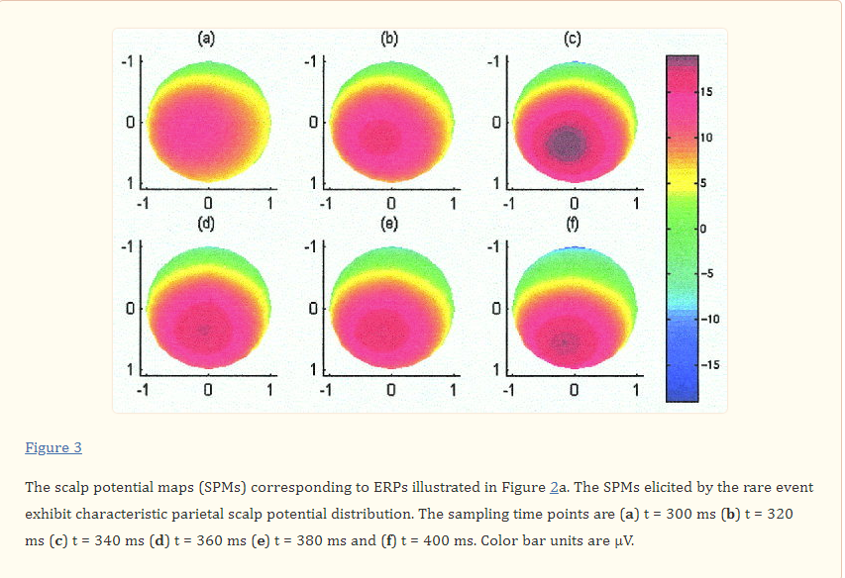

Slide 9
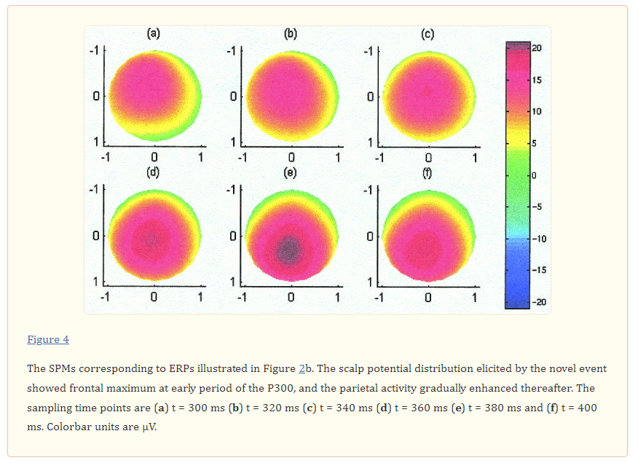

Slide 10
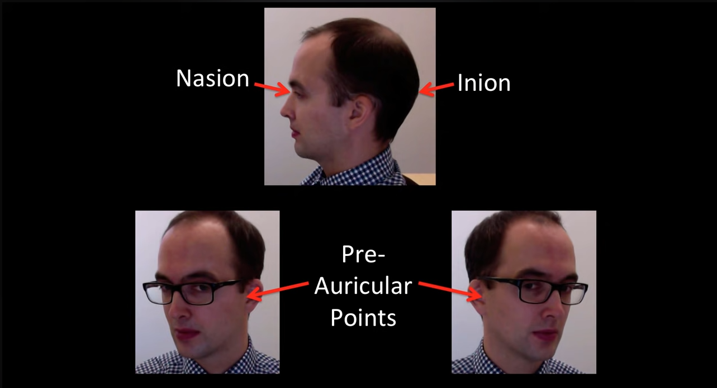
1020 System

Slide 11
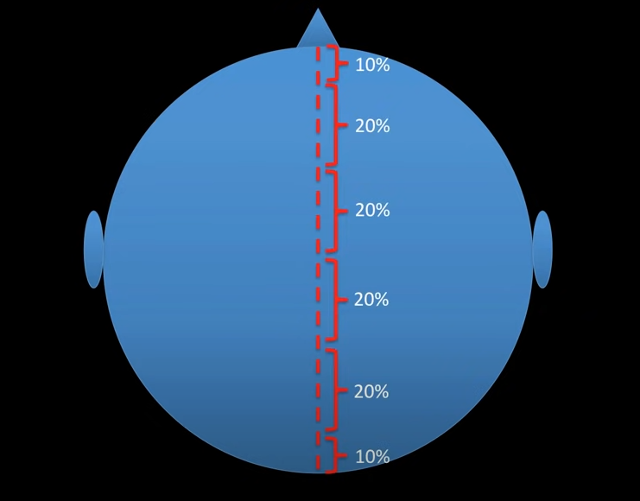
1020 System

Slide 12
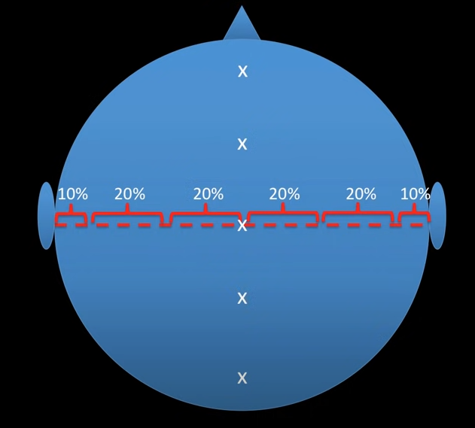
1020 System

Slide 13
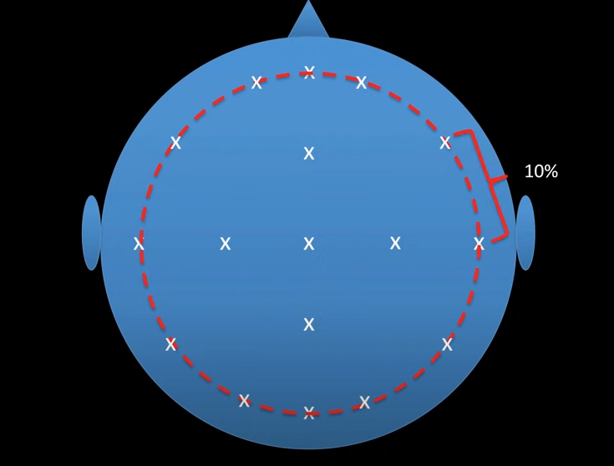
1020 System

Slide 14
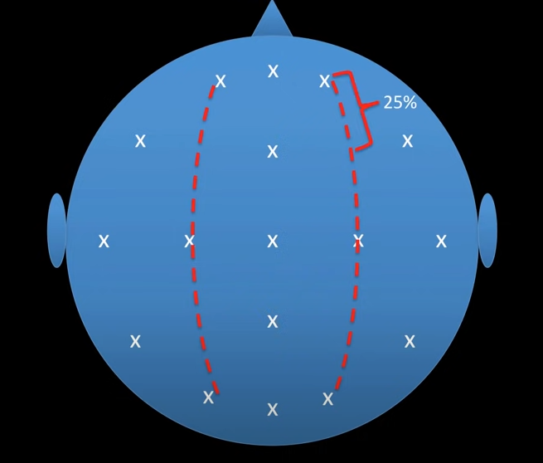
1020 System

Slide 15
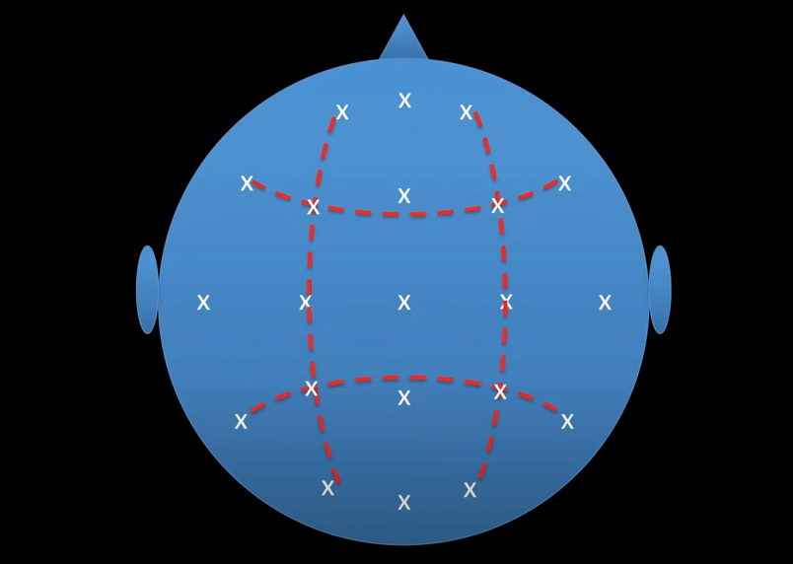
1020 System

Slide 16
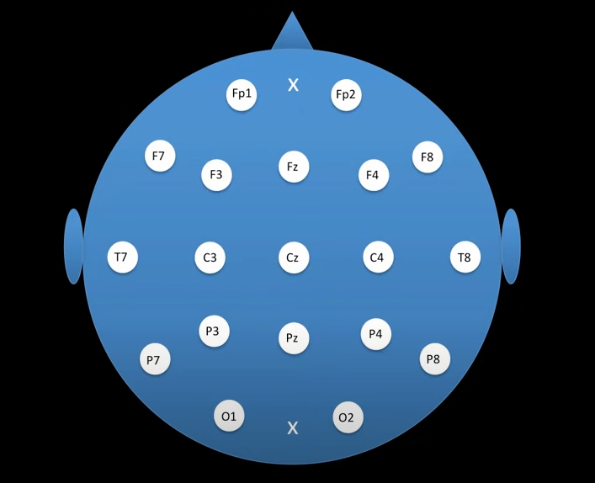
1020 System

Slide 17
electrodes
Electrodes can be defined as conductors that are used to make electrical contact with a non-metallic part of the circuit.
electrodes types
The Hydrogel-Based Electrode System (da bta3na ☺)
The system allows the acquisition of up to 64 biosignals such as EEG, EMG, EOG, ECG
The Water-Based Electrode System
The Dry-based Electrode System

Slide 18
ADC (analog Digital convertor)
convert an analog signal such as voltage to a digital form so that it can be read and processed by a microcontroller.
ADC resolution
Voltage range (0->5V)
Arduino uno ADC 10-bit 2^10 = 1024
Arduino mega ADC 12-bit 2^12 = 4096
Sound card resolution ( 16-bit , 18-bit , 20 )

Slide 19
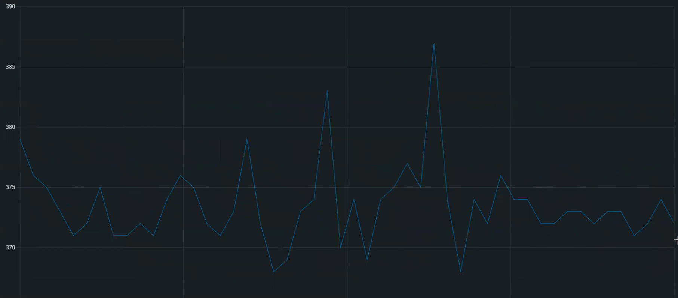
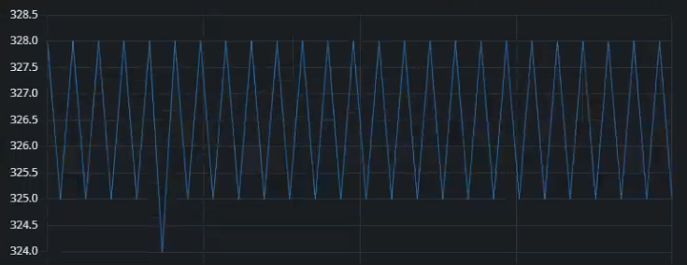
ADC (analog Digital convertor)
Arduino Mega
Arduino uno

Slide 20
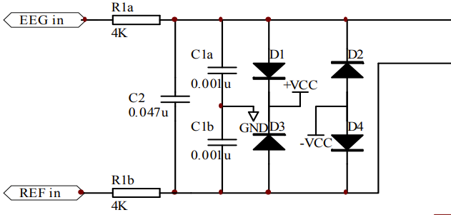
Protection

Slide 21
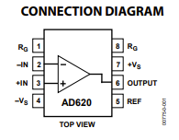
Amplifier
Voltage range 2-18V
Gain = (1+49400)/RG
It does not work perfectly

Slide 22
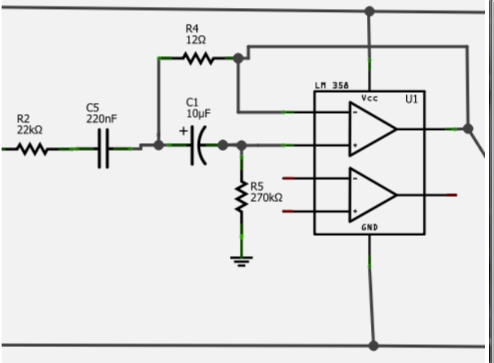
Notch Filter
Removes Power line noise (60)Hz.

Slide 23
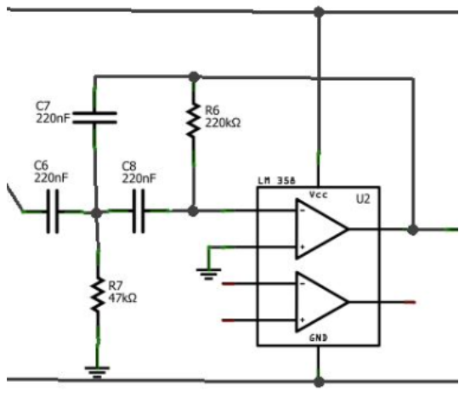
2-pole HPF
As we are measuring data across the skin, our final data will also contain voltage from our galvanic skin response across our head. This will obscure the brain data we want, and as this interference is primarily low frequency, it can be fairly easily filtered out with a high pass filter (HPF). The trade-off doing this is that we also filter out a lot of gamma/delta wave data (the brain waves that are about 8 Hz and less), but if our main focus is alpha/beta wave monitoring, this isn't much of a problem.

Slide 24
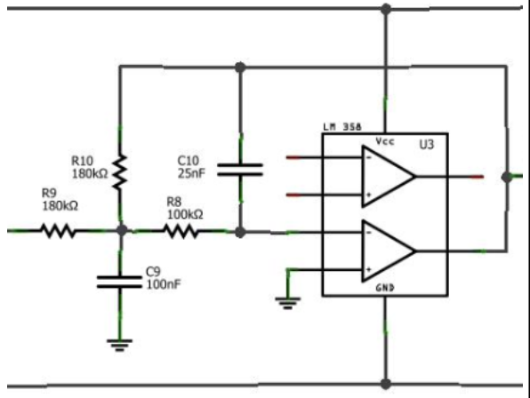
LOE pass filter (30)
Next up, we want to filter out data above the frequencies we are interested in. More specifically, as beta wave information stops out at 30Hz, we want to get rid of anything above that, as combined it can contribute a good amount of noise to our data. The circuit design is very similar to the high pass filter from stage 3 - it has a gain of .71 at 31.23Hz and decreases from there at a rate such that by 300Hz it has attenuated the data by about a factor of 100.

Slide 25
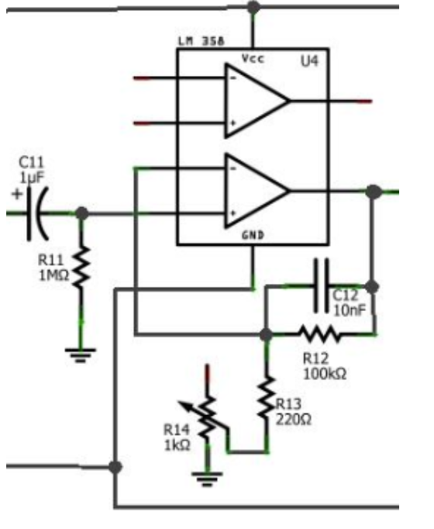
Another amplifier
Gain is on range(83-455) depending on the resistance value.
about 10 to 30 uV. Using a middle value of 20 uV, this means the ending voltage reading could range from 83*89.2*20e-6 = .148V to 455*89.2*20e-6 = .81172V.

Slide 26
Data transmission
We are currently transmitting data using USB.
We cannot connect USB to cell phones.
Wi-Fi and Bluetooth modules have belt-in ADCs

Slide 27
Sampling frequencies
E7na aslan mesh benrecoed el data f saba7 el fol.

Slide 28
Problems section
1. noise frequencies not calculated.
2. sound card would make noise when applying PCB.
3. ADCs are only 16-bit and not guaranteed to work well or deliver the desired quality.
4.transmiting data by Bluetooth or Wi-Fi without using the module ADC.
5.we need software to significantly analyze the output at each stage.
6. Record the data.
7. protection is not applied.

